Slide 1
Driving Student Consideration for Google Gemini Pro
Data-Driven Campaign & Creative Insights
Target Audience: Students (18–24)
Google Step Up Data Science Challenge
Faisa Ahmed | 2026

Slide 2
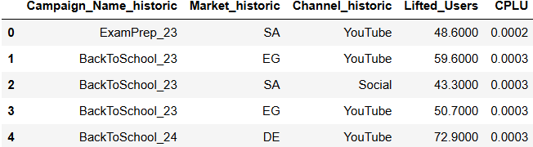
Which Campaigns Delivered the Strongest ROI?
• ExamPrep_23 (SA, YouTube) achieved the lowest CPLU ($0.0002)
• BackToSchool_24 (DE, YouTube) influenced the largest audience (~72.9M)
• YouTube consistently delivers the strongest efficiency + scale

Slide 3
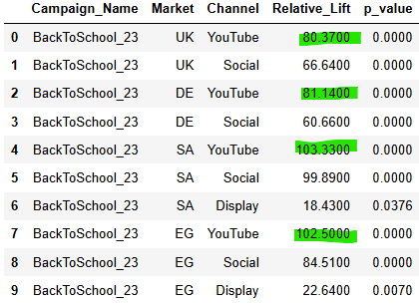
Which Campaigns Truly Increased Consideration?
Only statistically significant brand lift results (p < 0.05) were included.
Across all markets, YouTube consistently drove the highest consideration lift (80–103%), significantly outperforming Display.
Channel choice is a primary driver of impact.

Slide 4
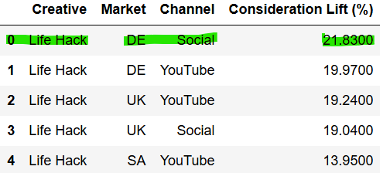
Which Creative Resonates Most with Students (18–24)?
• “Life Hack” is the highest-performing creative across all markets
• Peak lift: 21.83% (DE, Social)
• Strong and consistent performance across UK, SA, and EG
• Social slightly amplifies lift in DE

Slide 5




Recommended Strategy for Gemini Pro Student Campaign
Prioritise YouTube for Scale
YouTube consistently reached the largest number of students while keeping costs low, making it the most effective channel to scale
Lead with the “Life Hack” Creative Theme
The “Life Hack” ad generated the biggest increase in student consideration across multiple countries, making it the most persuasive creative concept.
Prioritise Germany and the UK
Campaigns in these markets showed the strongest increase in student interest, meaning our messaging resonates particularly well there.
Invest More in the Most Cost-Efficient Campaigns
Redirecting budget toward campaigns that influence students at the lowest cost will maximise overall impact without increasing spend.

